Slide 1
Automobile Market : - Competition and Vehicle Analysis -BY MIHIR HATTANGDI

Slide 2
AGENDA
DATA PROCESSING ON RAW DATA
TOP CARS BASED ON VARIOUS FACTORS
TOP MANUFACTURERS BASED ON VARIOUS FACTORS
POTENTIAL COMPETITORS AND CARS
STATISTICAL INFERENCES
KEY CORRELATIONS
FEATURE DISTIBUTIONS OF CARS BASED ON FUEL EFFICIENCY
CONCLUSION

Slide 3
DATA PROCESSING ON RAW DATA
CRITERIA FOR DELETING
MORE THAN 400 BLANKS IN COLUMNS AND MORE THAN 50 BLANKS IN ROWS
CRITERIA FOR IMPUTING
PURE NUMERICAL – MEAN (20 COLUMNS)
NUMERICALS WITH UNITS – MEDIAN (98 COLUMNS)
CATEGORICAL DATA – MODE (10 COLUMNS)

Slide 4
BASED ON CITY MILEAGE FOR EACH MANUFACTURERS
CARS
MILEAGE
USER REQUIREMENTS

Slide 5
BASED ON CITY DISPLACEMENT FOR EACH MANUFACTURERS
CARS
DISPLACEMENT
USER REQUIREMENT

Slide 6
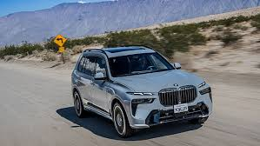
CARS FOR ADVENTURE
CARS
CRITERIA
POWER IN PS - HIGH
DISPLACEMENT -HIGH
GROUND CLEARANCE - LOW
LENGTH - 4,420 Mm
HEIGHT - 1,800 Mm
WIDTH -1,650 Mm

Slide 7
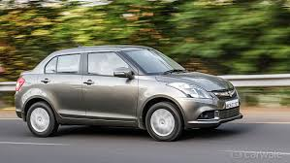
CARS FOR FAMILY
CARS
CRITERIA
MILEAGE – LOW (FUEL EFFICIENT)
FAMILY – IDEALLY 4
LENGTH- 3580mm
HEIGHT - 1490mm
WIDTH - 1645mm
DISPLACEMENT – LOW
FUEL TANK CAPACITY - HIGH

Slide 8
MAKE
MAKE
HYUNDAI AND SUZUKI OFFER MOST WIDEST RANGE OF CAR VARIANTS
AVERAGE FUEL EFFICIENCY FOR SUZUKI AND TATA IS THE HIGHEST

Slide 9
MANUFACTURERS
MAKE

Slide 10
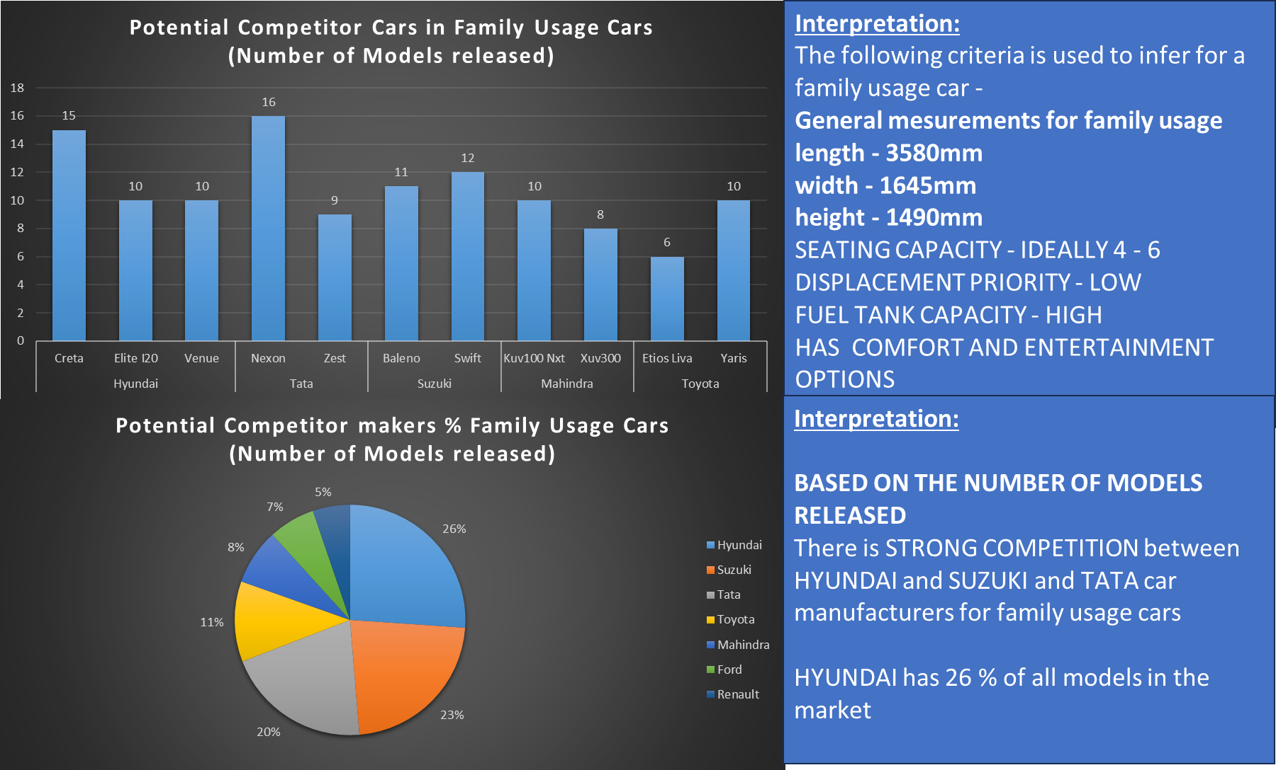
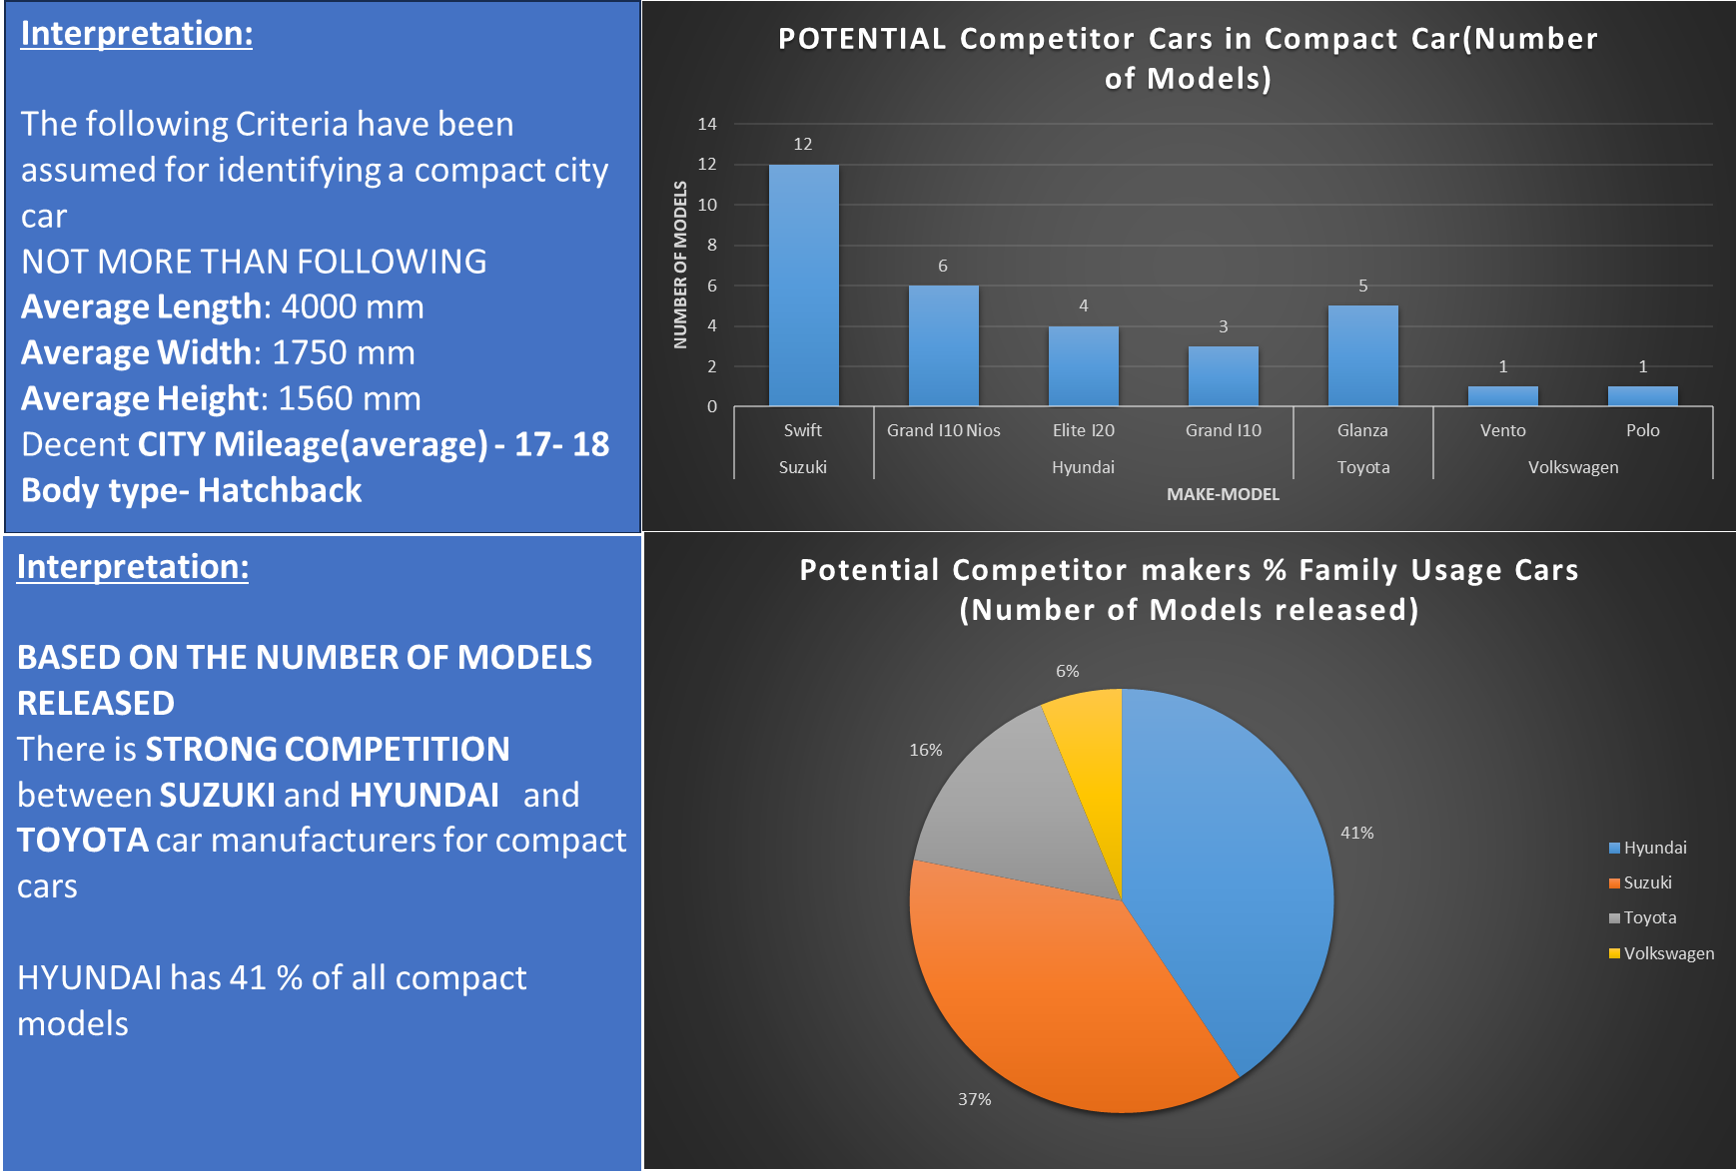

Slide 11
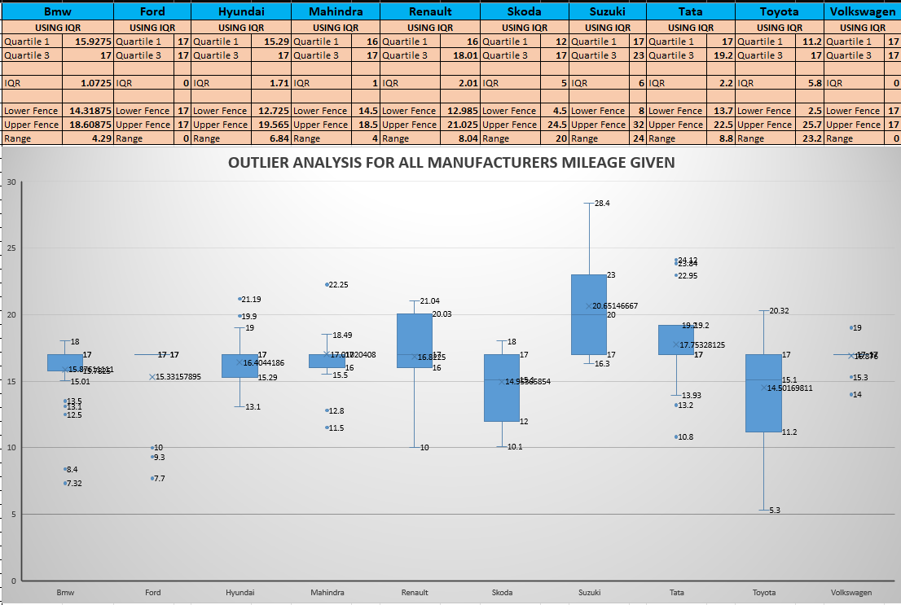
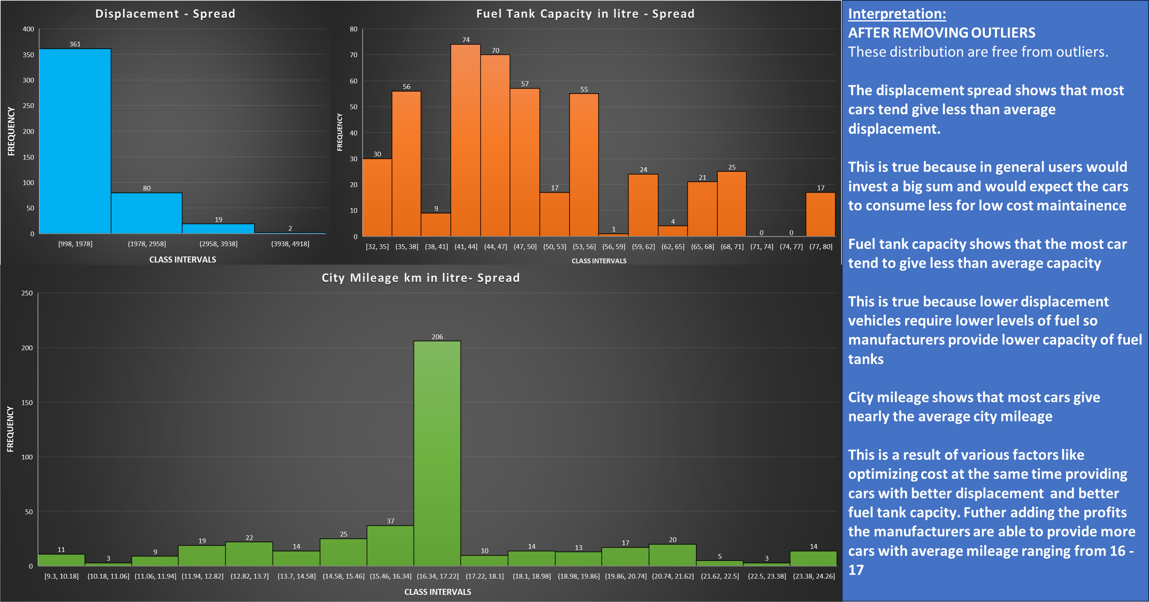
Suzuki gives widest and highest city mileage
TOYOTA the lowest
AVERAGE – 1621.77
AVERAGE – 16.76
AVERAGE – 49.58

Slide 12
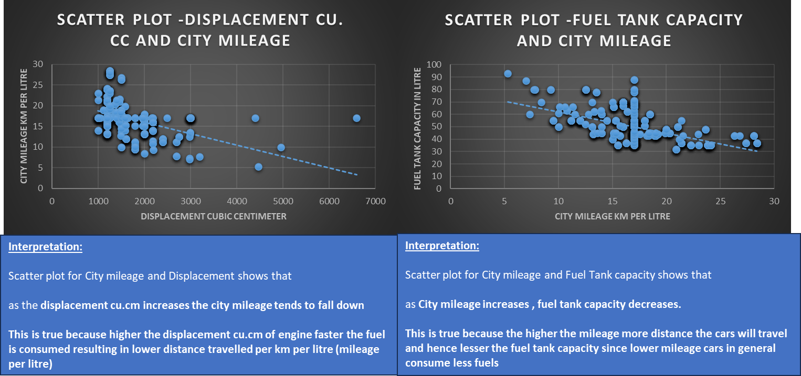
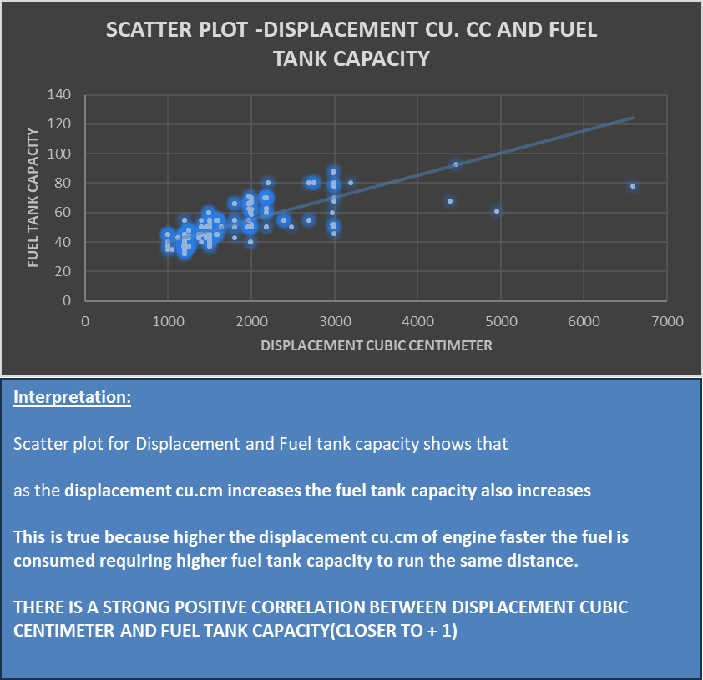
Interpretation:
CORRELATION FOR AVG SPEED
YES - 0.7682 = 77%
NO - 0.89736 = 90 %
There is a high correlation between fuel tank capacity and distance travelled
More distance the car travels more fuel it requires hence there is a strong correlation between fuel tank capacity and distance travelled irrespective of the average speed being yes or no.
Comparing the 2 category
NO avg speed is more correlated than YES

Slide 13
FEATURE DISTRIBUTION BASED ON FUEL EFFICIENCY
CRITERIA | HIGH | MODERATE | LOW
Cylinders | Maximum 4 | Ranges from 3 – 6 | Ranges to 6
Displacement (cc) | 900 – 2000 | 900 – 7000 | 900 – 5000
Drive-Train | FWD’s mostly | FWD’s mostly | RWD’s mostly
Fuel-Type | Diesel | Diesel – Hybrid – Electric | Petrol
Height (mm) | 1300 – 2000 | 1300 – 2000 | 1300 – 2000
Width (mm) | 1600 – 2100 | 1400 – 2300 | 1600 – 2300
Length (mm) | 3600 – 4500 | 3600 – 5700 | 3600 – 5700
CRITERIA | HIGH | MODERATE | LOW
Popular Body-Style | Hatchback-Sedans | SUV – Sedans | SUV - Sedans
Fuel-Tank-Capacity (kgs) | 30 – 60 | 30 – 90 | 30 - 95
Kerb Weight (kgs) | 800 – 1500 | 1000 – 2000 | 1000 – 3000
Gross Weight (kgs) | 1000 – 2500 | 1500 – 3000 | 1500 – 3500
Ground-Clearance (mm) | 160 – 200 | 160 – 200 | 120 – 225
Seating-Capacity(incl. driver) | More than 5 | 4 – 5 | 4 - 5

Slide 14
CONCLUSIONS
OVERALL BEST MANUFACTURER - SUZUKI
BEST MANUFACTURER FOR POPULAR BODY STYLES - HYUNDAI
BEST MANUFACTURERS FOR COMPACT AND FAMILY BASED CARS – SUZUKI & HYUNDAI
BEST MANUFACTURER ENGINE POWER & DISPLACEMENT – BMW & FORD
BEST CAR FOR ADVENTURE - Bmw X7 Xdrive 40I
BEST CAR FOR FAMILY - Suzuki Dzire Vdi
BEST CAR MODEL FOR AVERAGE FUEL EFFICIENCY – TATA TIAGO
TO INCREASE CITY MILEAGE REDUCE DISPLACEMENT AND INCREASE FUEL TANK CAPACITY
Notes:
SUZUKI IS THE BEST MANUFACTURER BASED ON MILEAGE, DISPLACEMENT AND CHOICES OF MODELS AND VARIANTS AVAILABLE
HYUNDAI IS BEST MANUFACTURER PROVIDING ALL THE TOP 3 POPULAR BODY TYPE CARS - SEDAN, SUV, HATCHBACK
SUZUKI AND HYUNDAI BOTH PROVIDE OPTIMAL CARS BASED FOR USERS SPECIFICALLY WANTING FAMILY BASED CARS AND COMPACT CARS.
Bmw X7 Xdrive 40I IS THE BEST CAR BASED ON ENGINE POWER , ESPECIALLY FOR ADVENTURE LOVERS
Suzuki Dzire Vdi IS THE BEST CAR BASED ON MILEAGE AND COMFORT AND LONG DRIVES , ESPECIALLY FOR FAMILY OUTING
TOP POTENTIAL COMPETITOR CAR MAKERS FOR COMPACT CITY CARS AND FAMILY USAGE CARS - HYUNDAI AND SUZUKI

Slide 15
Thank you
PRESENTED
BY
MIHIR HATTANGDI

